Slide 1
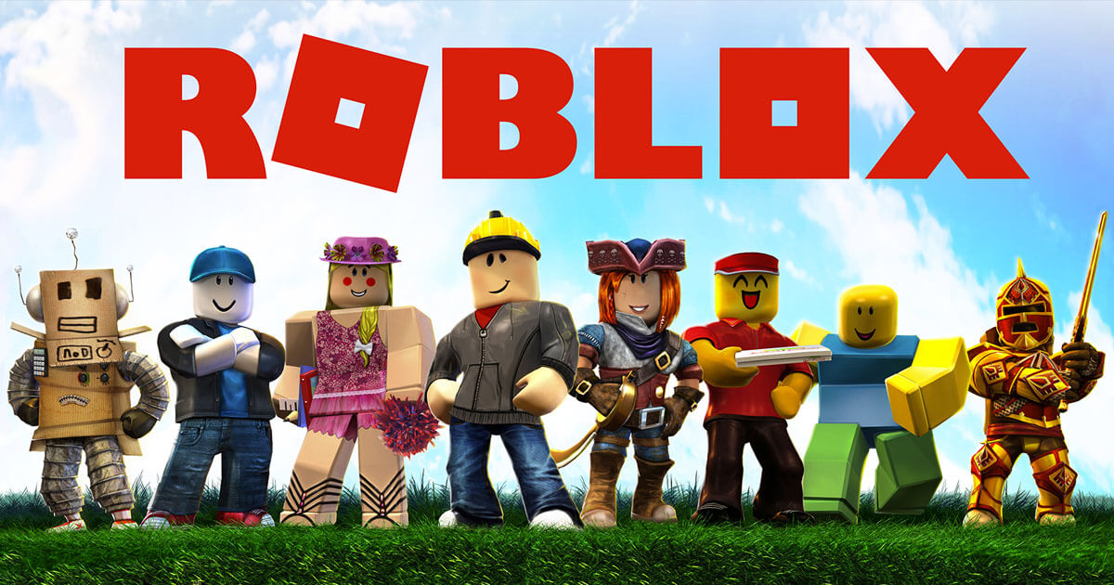
Term Project
Week

Slide 2
COURSE TIMELINE
Term Project
Programming Projects with Lua
Roblox Studio Basics
Constraints Pt 1
Constraints Pt 2
Intro to Lua
Parameters
Loops & Conditionals
Functions
W1
W2
W3
W4
W5
W6
W7
W8

Slide 3

Edmodo
Resource Hub
Slides
Learning Material
Exercises/ Assignments / Quizzes
Tutorial Videos
WHEN TO CHECK
FRIDAY AFTERNOON EVERY WEEK
Communication
Directly message teachers
Post Questions
Post Screenshots of your work

Slide 4
Getting Started
Download
TermProject.rblx
Worksheet Wk5

Slide 5
TODAY’S LESSON
1
QUICK REVISION
2
CLASS PROJECT: RACING GAME

Slide 6



REVIEW: VARIABLES
Variables are useful for storing things that change
LOCAL VARIABLES
Can only be accessed in your file.
102
create variables:
fav_num = 102
GLOBAL VARIABLES
Can be accessed anywhere.
fav_num
print variables:
print(fav_num)
Notes:
Let's say you’re in a big warehouse, with a lot of boxes. How will you be able to access or remember something that you put in one of the box?
LABEL THE BOX!!
Variables is like the label on the box. As humans, it is easier for us to remember a name or label than an exact block of information. Variables let us store information, recall and reuse them.

Slide 7
REVIEW: BOOLEANS (TRUE OR FALSE)
Computers store whether a condition is met in the form of True and False
To figure out if something is True or False we do a comparison
>>> "A" in "AEIOU" >>> "Z" in "AEIOU"
>>> "a" in "AEIOU"
True
False
False
Notes:
How do computers make decisions

Slide 8
REVIEW: CONDITIONAL STATEMENTS
Conditions let us make decision.
First we test if the condition is met!
Then maybe we’ll do the thing
fave_num = 15
if fav_num < 10:
print("What a great number")
elif fav_num = 11:
print("I love the number 11")
else:
print("I only like numbers below 11")

Slide 9
CLASS PROJECT

Slide 10
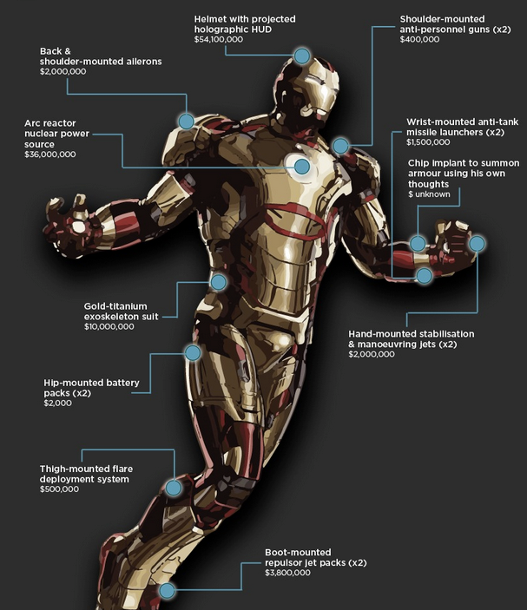
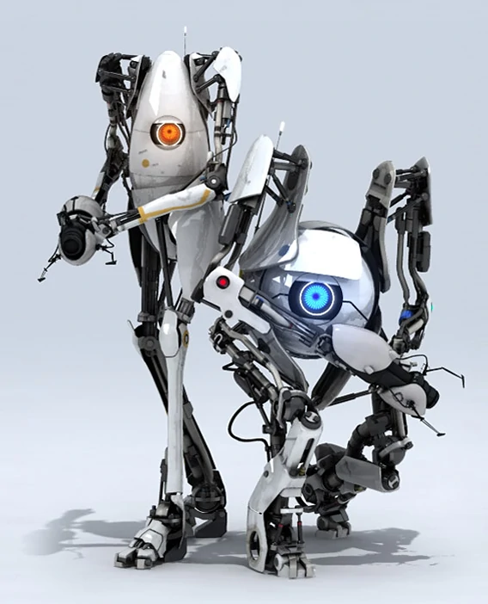
BUILDING THINGS WITH CONSTRAINTS
When we start looking at building more sophisticated games and machines, things can get complicated really fast.
In the real world, machines aren’t just made up of one constraint.
Often, we need to use multiple constraints (sometimes even hundreds) together to get machines to do stuff.

Slide 11
GAME DEVELOPMENT PROCESS
Here’s how game developers think. . .
IDEATE
DEVELOPMENT
LAUNCH
Figure out what you want to build and any cool features you might want to add.
Start building it using Roblox Studios. One step at a time.
Once your game is ready, publish and share it live onto Roblox!
DESIGN
TEST
Plan out what parts you need, the types of constraints and how it all works together. Then try breaking it down into steps for building
Continually test your machine! Test after you finish each component and anytime you add something new.

Slide 12
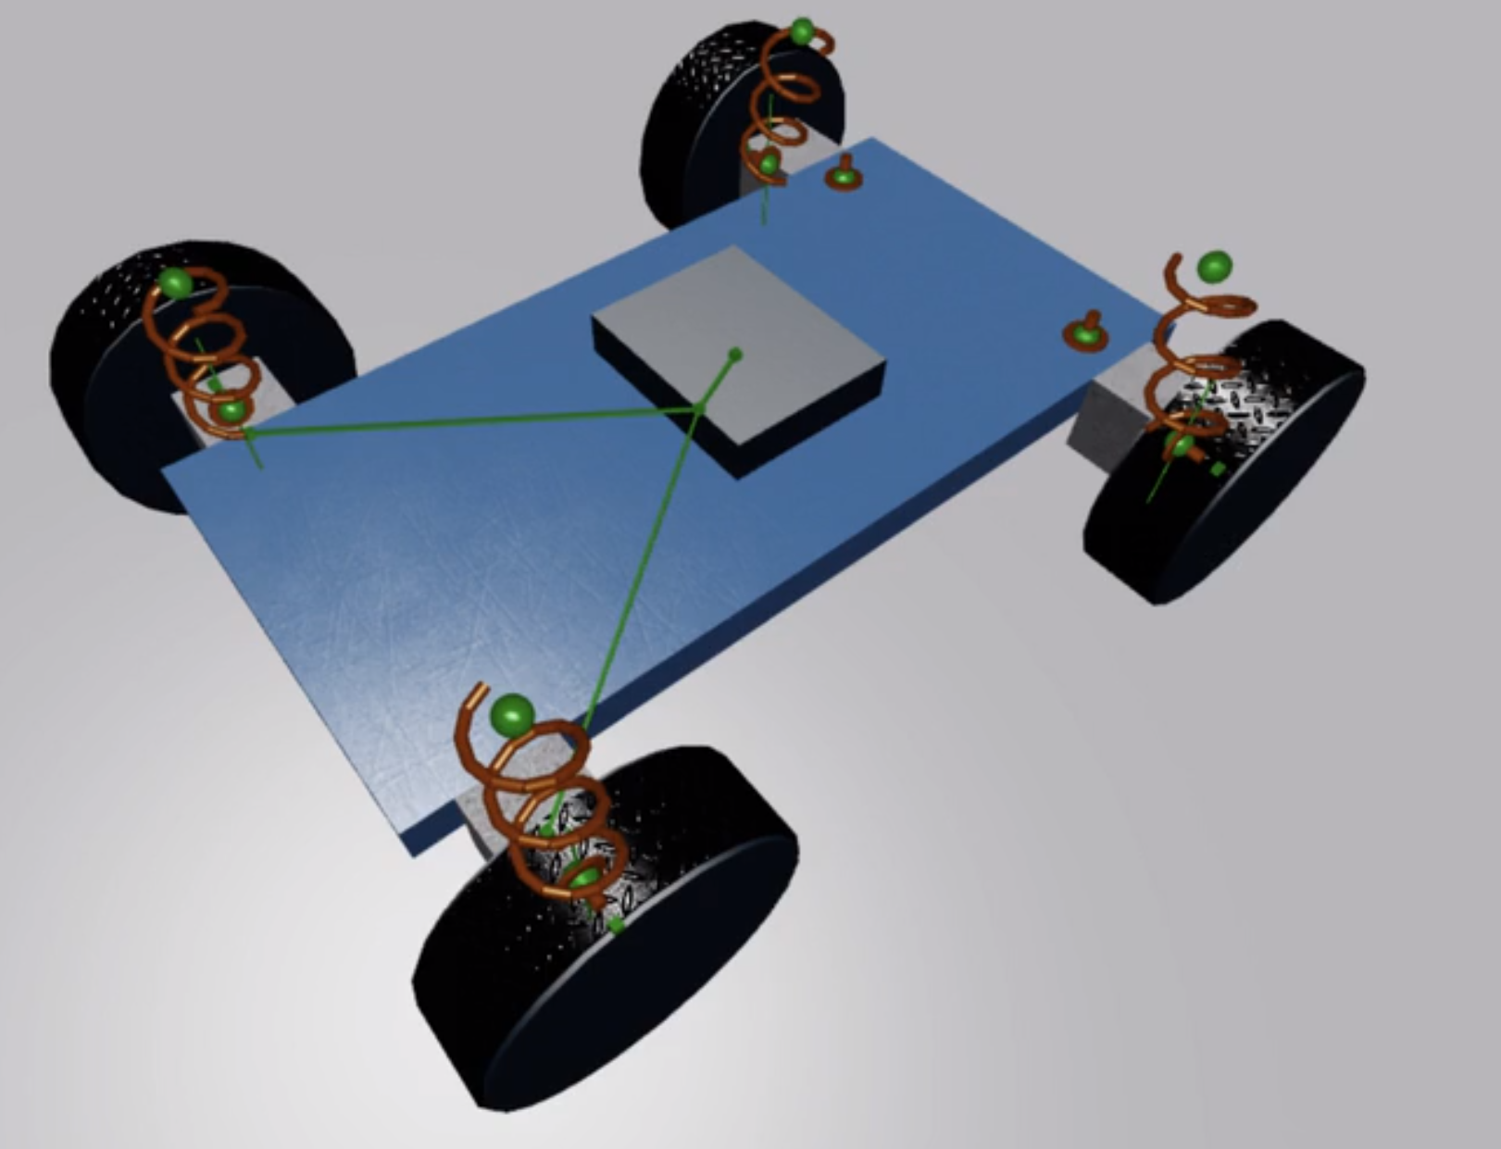
BUILDING A CAR
Game Development Process
IDEATE: We want to build a Racing Car in Roblox.
What should a car be able to do?
What are some cool features we could add?
DESIGN:
What parts can you see?
What constraints?
Where do we start?
TESTING:
When should we test?

